Slide 1
Exception

Slide 2
Exception: Syntax
DECLARE handler_action HANDLER
FOR condition_value [, condition_value] ... statement
handler_action:
{ CONTINUE | EXIT | UNDO }
condition_value:
{ mysql_error_code | SQLSTATE [VALUE] sqlstate_value | condition_name | SQLWARNING | NOT FOUND | SQLEXCEPTION }
The DECLARE ... HANDLER statement specifies a handler that deals with one or more conditions.
If one of these conditions occurs, the specified statement executes. statement can be
a simple statement such as SET var_name = value, or
a compound statement written using BEGIN and END

Slide 3
Exception: hadler_action
The handler_action value indicates what action the handler takes after execution of the handler statement:
CONTINUE: Execution of the current program continues.
EXIT: Execution terminates for the BEGIN ... END compound statement in which the handler is declared.
UNDO: MySQL does not support

Slide 4
Exception: condition_value
mysql_error code: This value is numeric. It is MySQL-specific and is not portable to other database systems
SQLSTATE [VALUE] :This value is a five-character string (for example, '42S02'). SQLSTATE values are taken from ANSI SQL and ODBC and are more standardized than the numeric error codes
condition_name: A condition name previously specified with DECLARE ... CONDITION. A condition name can be associated with a MySQL error code or SQLSTATE value.
SQLWARNING: Shorthand for the class of SQLSTATE values that begin with '01‘
NOT FOUND: Shorthand for the class of SQLSTATE values that begin with '02‘
SQLEXCEPTION: Shorthand for the class of SQLSTATE values that do not begin with '00', '01', or '02'

Slide 5
Exception: condition_value
mysql_error_code: An integer literal indicating a MySQL error code, such as 1146 to specify “unknown table”:
create procedure demo1()
begin
declare br char(10);
declare continue handler for 1146
select bcode into br from branch111 where strenght = 40;
select ‘HELLO’;
end;

Slide 6
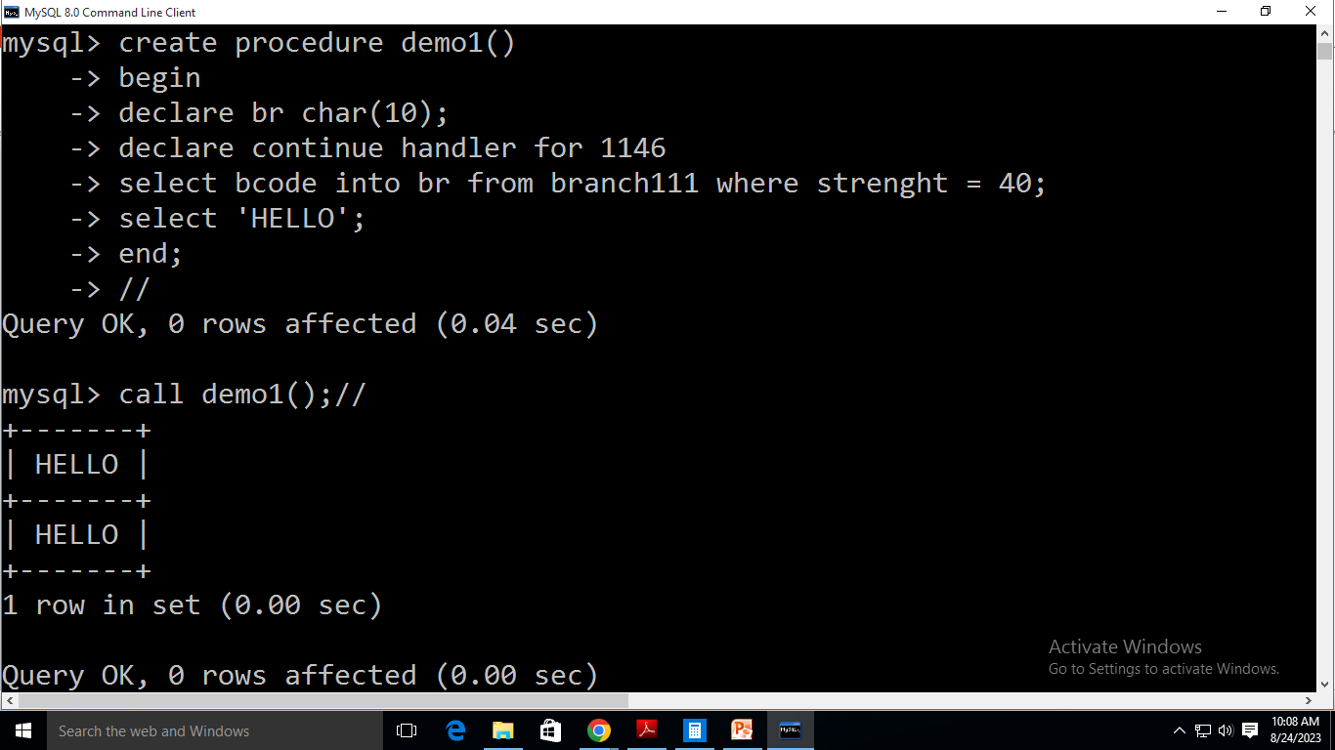
Output

Slide 7
Exception: condition_value
mysql_error_code: An integer literal indicating a MySQL error code, such as 1146 to specify “unknown table”:
create procedure demo1()
begin
declare br char(10);
declare exit handler for 1146 begin end;
select bcode into br from branch111 where strenght = 40;
select ‘HELLO’;
end;

Slide 8
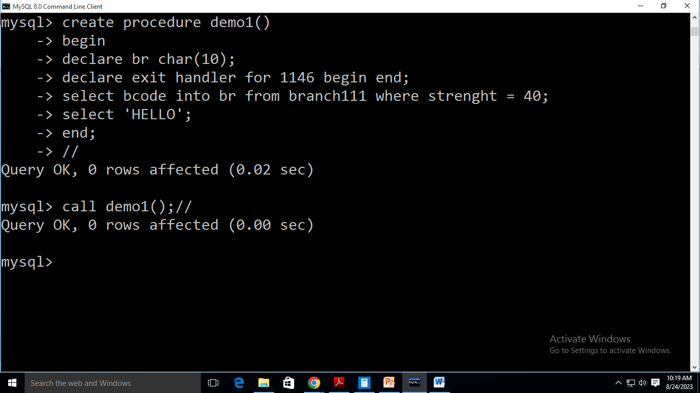
Output

Slide 9
Exception: condition_value
SQLSTATE [VALUE] sqlstate_value: A 5-character string literal indicating an SQLSTATE value, such as ’42S02' to specify “unknown table”:
create procedure demo1()
begin
declare br char(10);
declare exit handler for sqlstate ’42S02’ begin end;
select bcode into br from branch111 where strenght = 40;
select ‘HELLO’;
end;

Slide 10
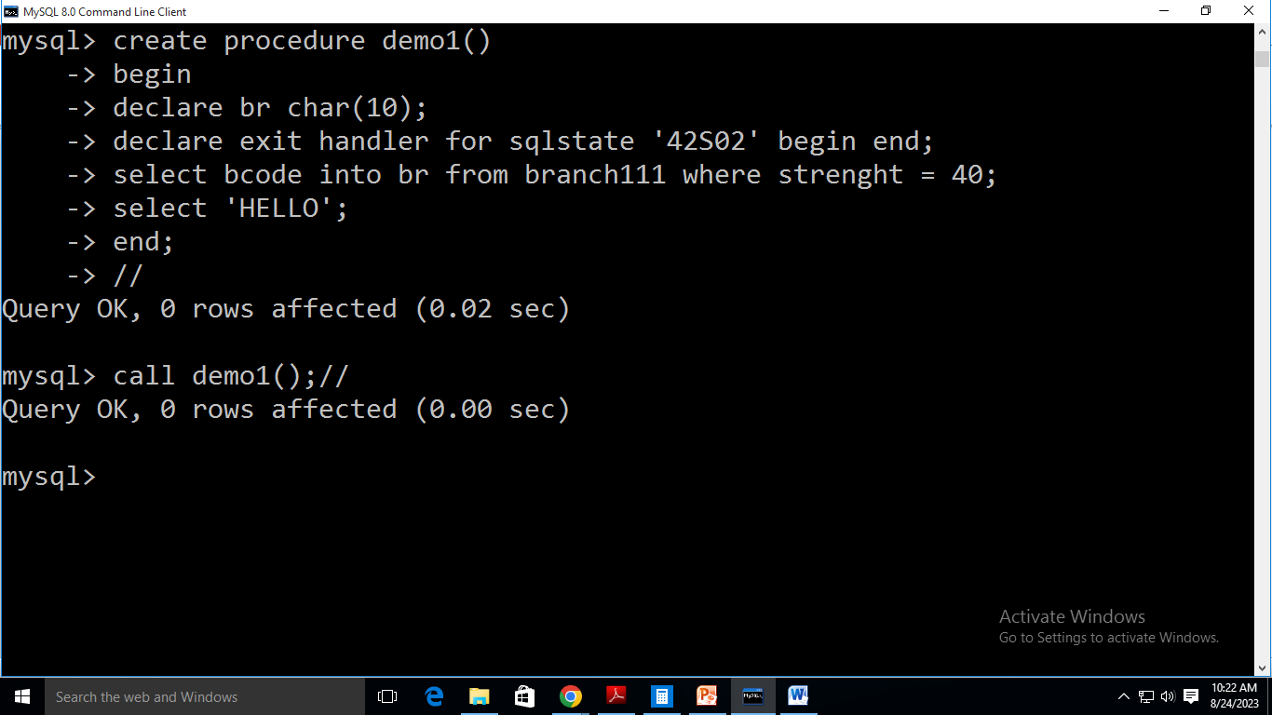
Output

Slide 11
Exception: condition_value
NOT FOUND:
create procedure demo1()
begin
declare br char(10);
declare continue handler for not found
select bcode into br from branch where strenght = 40;
select ‘HELLO’;
end;

Slide 12
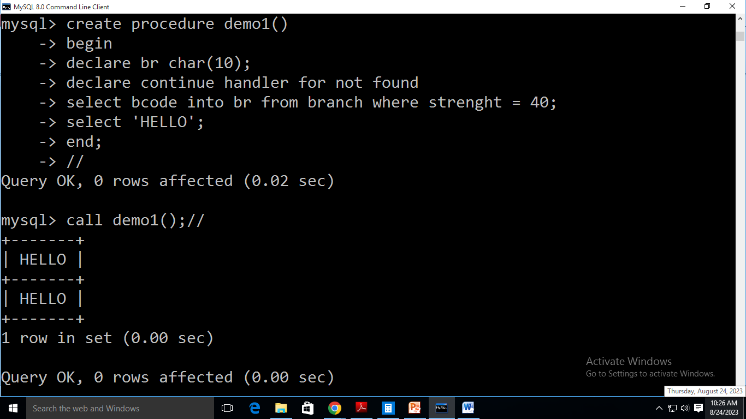
Output

Slide 13
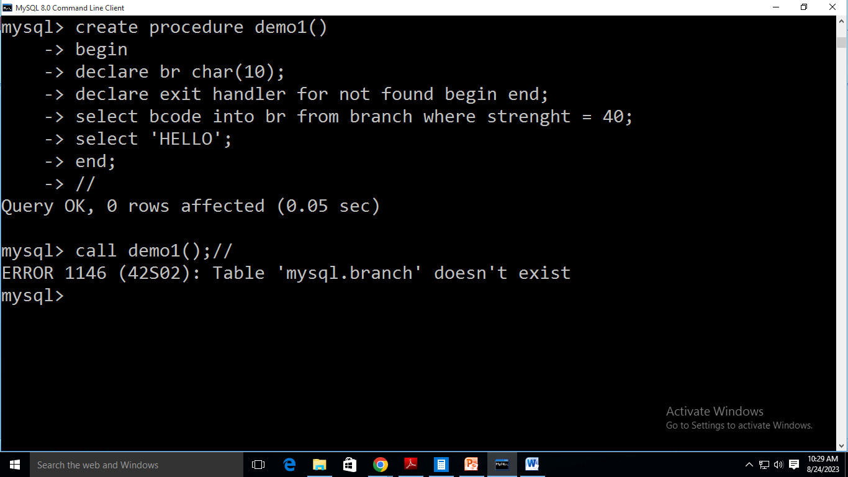
Output

Slide 14
Exception: condition_value
SQLEXCEPTION:
create procedure demo1()
begin
declare continue handler for SQLEXCEPTION
insert into branch values(‘aaaaaaaaaa’, ‘ss’, 33);
select ‘HELLO’;
end;

Slide 15
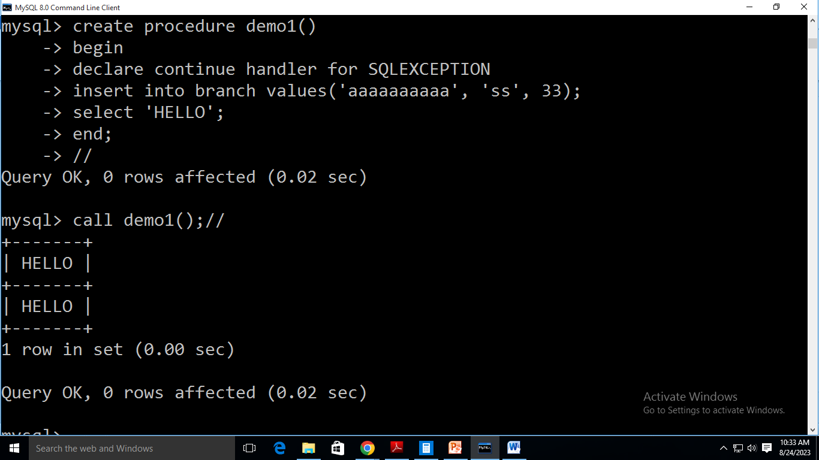
Output

Slide 16
Exception: Precedence
When the server finds one or more applicable handlers at a given scope, it chooses among them based on condition precedence:
A MySQL error code handler takes precedence over an SQLSTATE value handler.
An SQLSTATE value handler takes precedence over general SQLWARNING, SQLEXCEPTION, or NOT FOUND handlers.
An SQLEXCEPTION handler takes precedence over an SQLWARNING handler.

Slide 17
DECLARE ... CONDITION Statement
The DECLARE ... CONDITION statement declares a named error condition, associating a name with a condition that needs specific handling.
The name can be referred to in a subsequent DECLARE ... HANDLER statement
DECLARE condition_name CONDITION FOR condition_value
condition_value:
{ mysql_error_code | SQLSTATE [VALUE] sqlstate_value }

Slide 18
DECLARE ... CONDITION Example
create procedure demo1()
begin
declare br char(10);
declare no_table condition for 1146;
declare continue handler for no_table
select bcode into br from branch111 where strenght = 40;
select ‘HELLO’;
end;

Slide 19
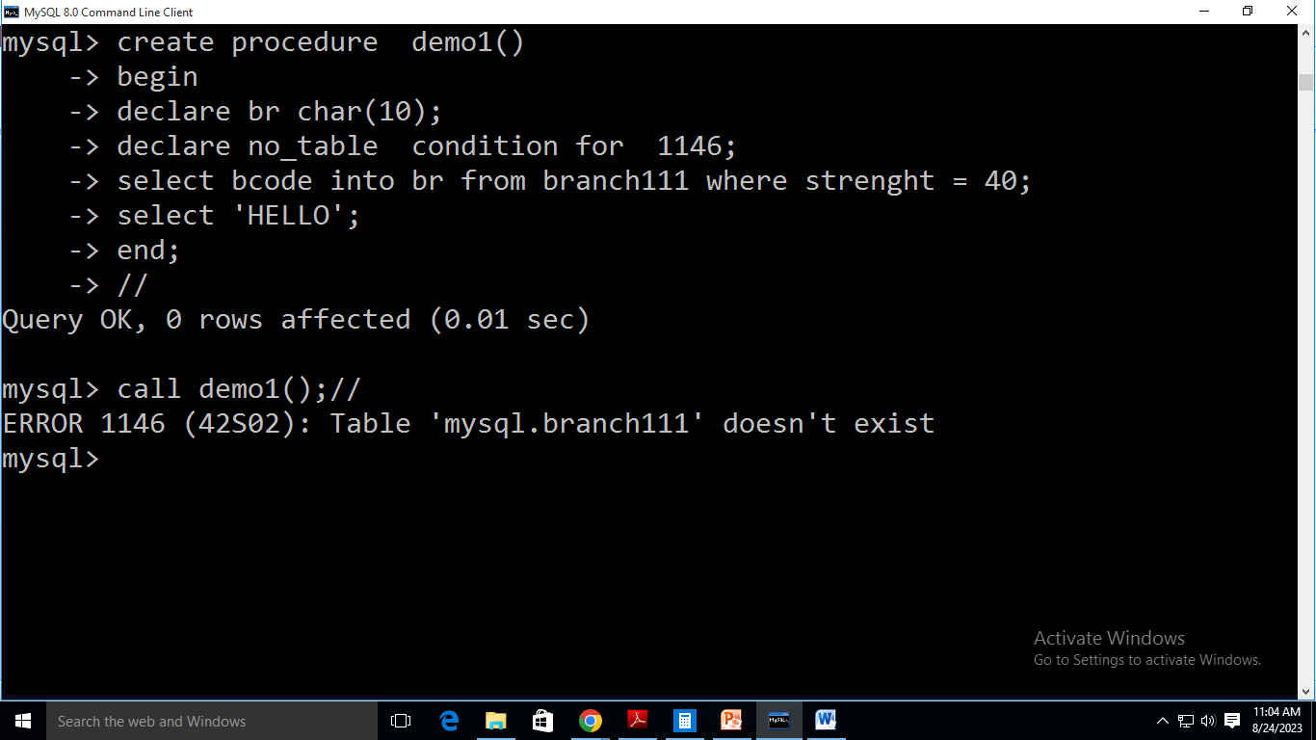
Output

Slide 20
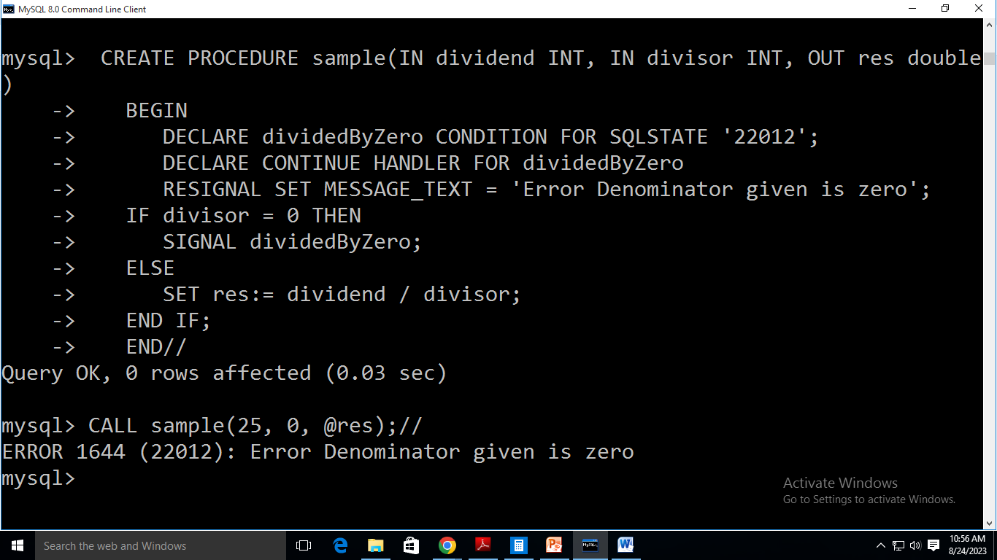
Raise Exception Example

